Slide 1
Hugh Christie fourth annual Science Fair
Exclusively for Year 8 and 9

Slide 2
What is a Science Fair project?
A real life investigation PLANNED AND CARRIED OUT BY YOU to answer a real life scientific question of your choice
Is Yawning Contagious?
Which type of bubble gum will blow the biggest bubbles?
Do fish really have a one second memory?

Slide 3
This is not a research project!
While research may be an important component of planning the direction of the project, students are asked to choose a question that is testable and plan and perform an experiment to prove if their hypothesis is right or wrong
Does eating carrots allow you to see better in the dark?
Can a football be kicked further if it is filled with helium or air?
What are the bones in the human body?

Slide 4
What Are you competing for?
Winners will get a medal engraved with your name and date of their win
Winners will get their picture in the local newspaper
All students will be competing for House points
All students will be getting recognition for their skills through SKILLS BUILDER
Science Badges given for select groups with exceptional projects

Slide 5
JUDGES
All projects will be evaluated Executive Principal Mr Barker, the School Governors and previous 1st place winner Alex Martin (Year 11)

Slide 6
This is a Competition
Bronze Medal– THIRD Place
Silver Medal– SECOND place
Gold Medal- FIRST place
TROPHY and plaque with your name
and will become a Judge the following year
Peoples Choice (voted by your peers )
House Points will be issued to each project by guest Judges… the house with the most points wins

Slide 7
Groups
Students may choose to work…
INDEPENDENTLY
IN A PAIR
IN A GROUP OF NO MORE THAN 4
IN ADVISORY GROUPS

Slide 8
Judges will be looking at
Presentation
Originality
Use of the scientific method
Oral Explanation

Slide 9
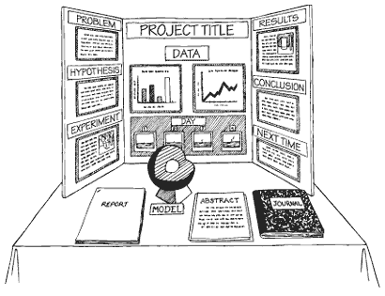
Presentation
A good presentation is
COLOURFUL
HAS CLEAR HEADINGS
HAS PICTURES AND DIAGRAMS
HAS GRAPHS
HAS A MODEL OR IS INTERACTIVE

Slide 10
Originality
Investigative something that YOU would like to know about the World
Be original and start with your interests

Slide 11
USE THE Scientific METHOD
Tips
Start with a question that you have always wanted to know the answer to.
Ask yourself FIRST is this something I can test?
Come up with a prediction as to what you think the answer might be
Create a method that will answer the question
Is this a fair test? What variables must I control to make sure I am creating reliable results
remember only one thing can be changed in a proper scientific investigation
Collect your data in a results table or through detailed observations
Make a graph to show your data
Make a conclusion using the data

Slide 12
explanation
How well can you explain your project ?
Be prepared to answer some questions about your project from the Judges
The questions you should be prepared to answer…
Why did you want to ask this question ?
How did you do your experiment?
What did you find out?
How did you make sure you results were reliable ?
What might you do different next time?

Slide 13
SKILLS BUILDER
Science Fair will take place for year 8s and 9s on July 6th (ON SKILLS BUILDER DAY )
This is your unique opportunity to showcase your skills builder skills in a different way

Slide 14
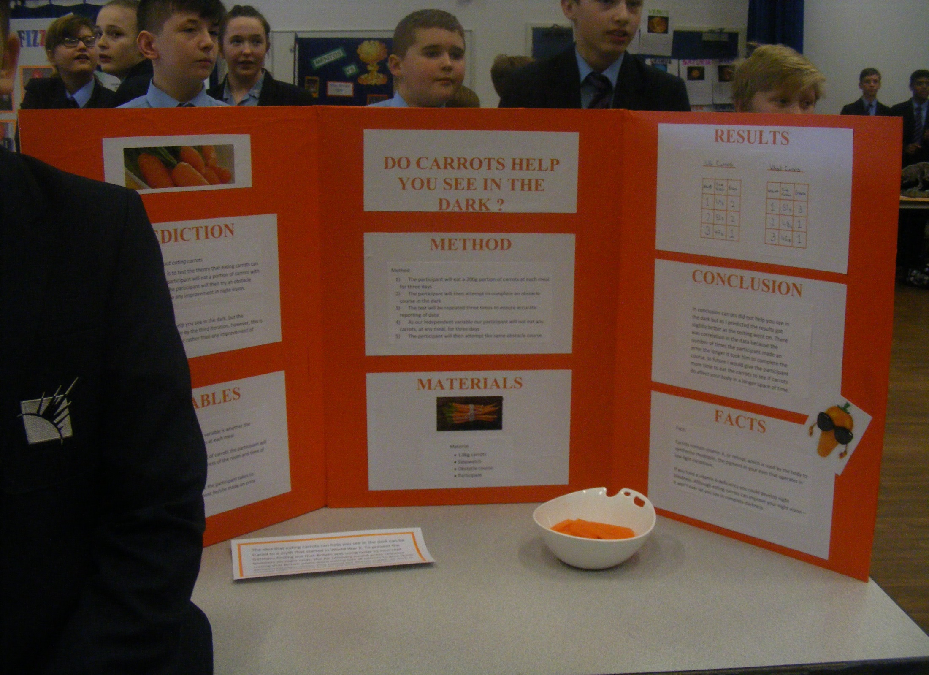
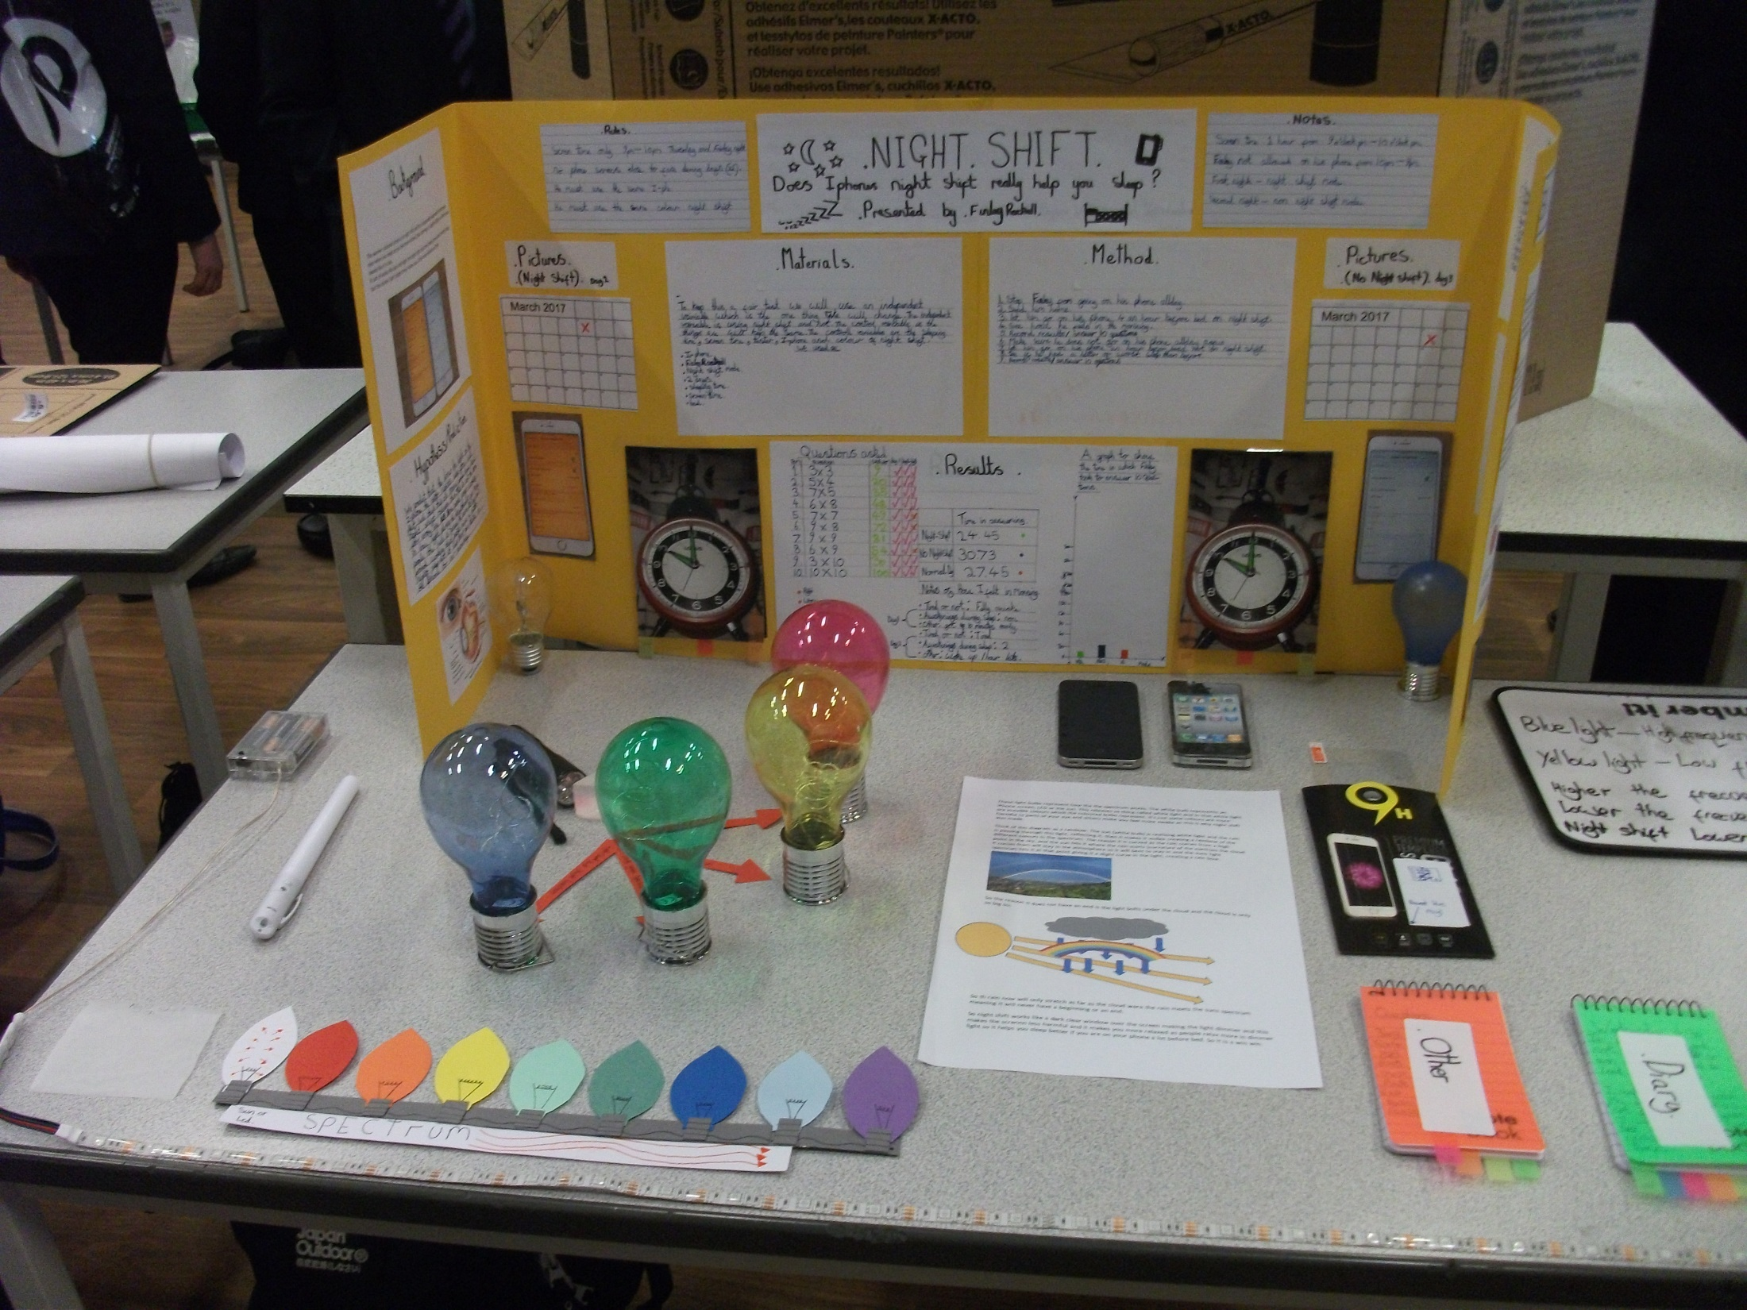
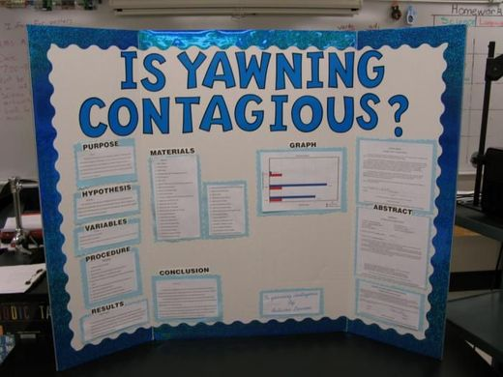
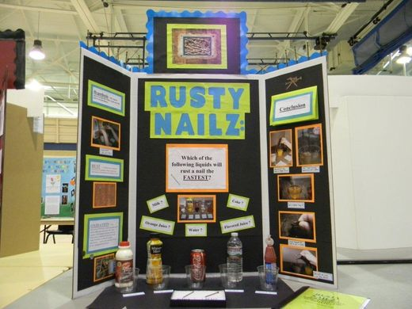
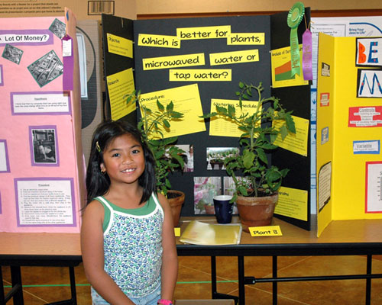
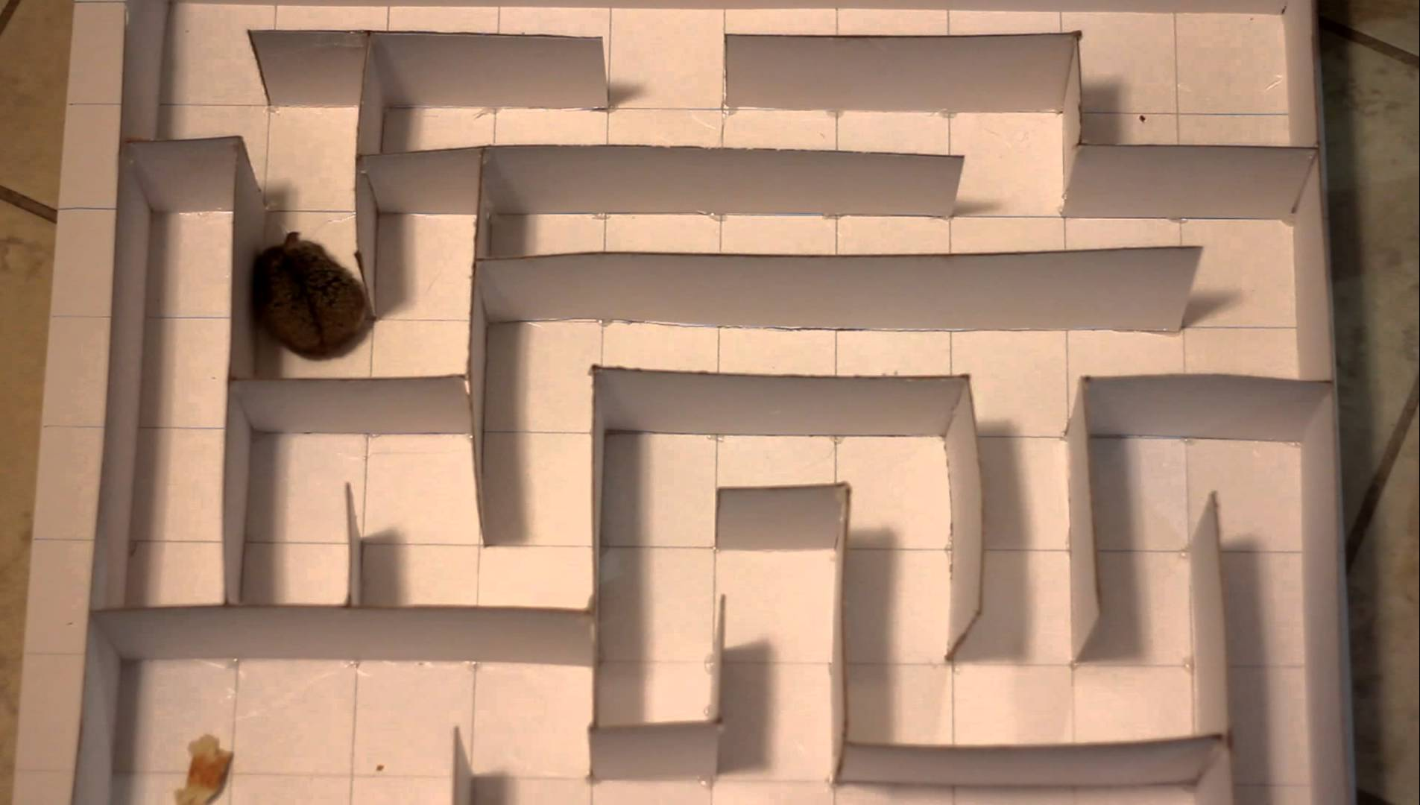
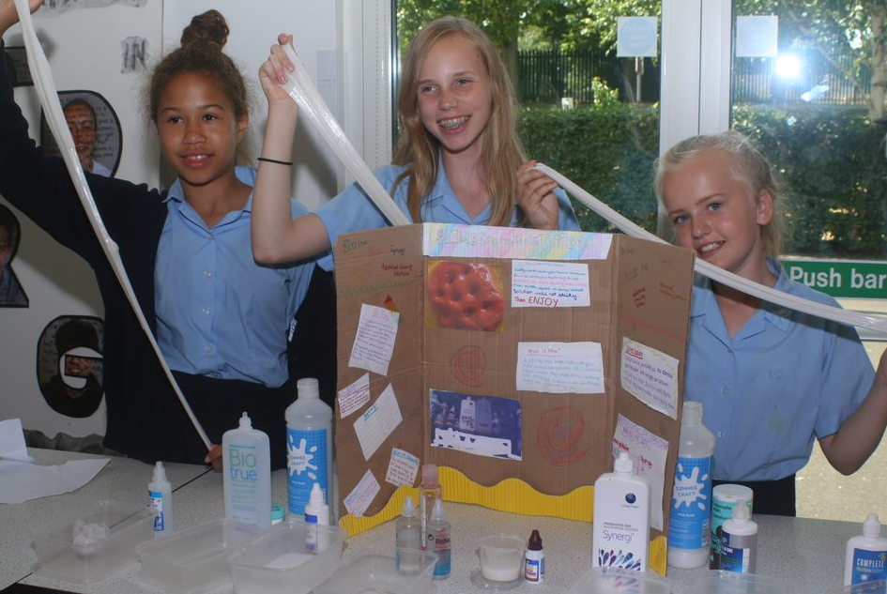
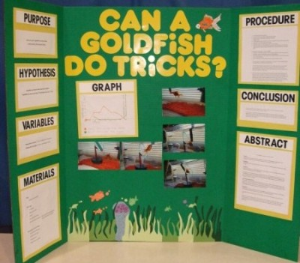
Possibilities are endless

Slide 15
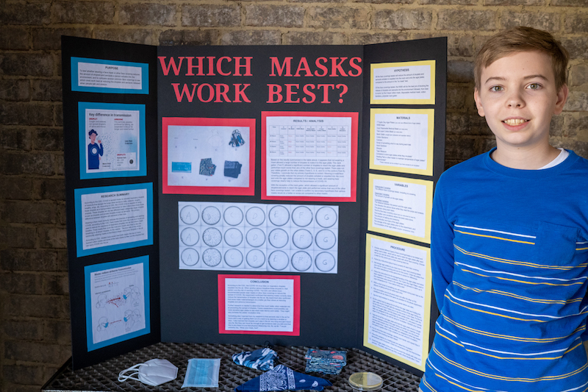
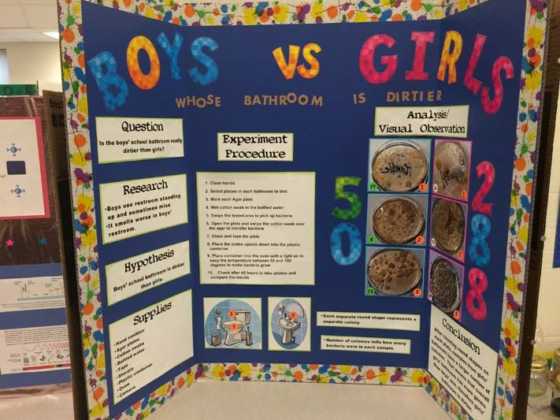
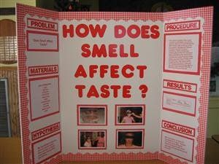
Not sure what you want to do ?
Start with something your interested in knowing…
Use the internet! Google science fair and images and you come up with loads of ideas

Slide 16
EXAMPLES
HOW COULD WE TEST THIS?

Slide 17
EXAMPLES
Does being related to each other affect the similarities of fingerprint?

Slide 18
EXAMPLES
Do McDonalds fries really never go bad?
Which skittles do people like the most ?
Which nail varnish lasts longest?
Which beverage has the most sugar?
Which type of slime stretches the furthest?
Does my dog prefer steak or bacon?
What volume of water needed for the perfect bottle flip?
OPPORTUNITIES ARE ENDLESS

Slide 19
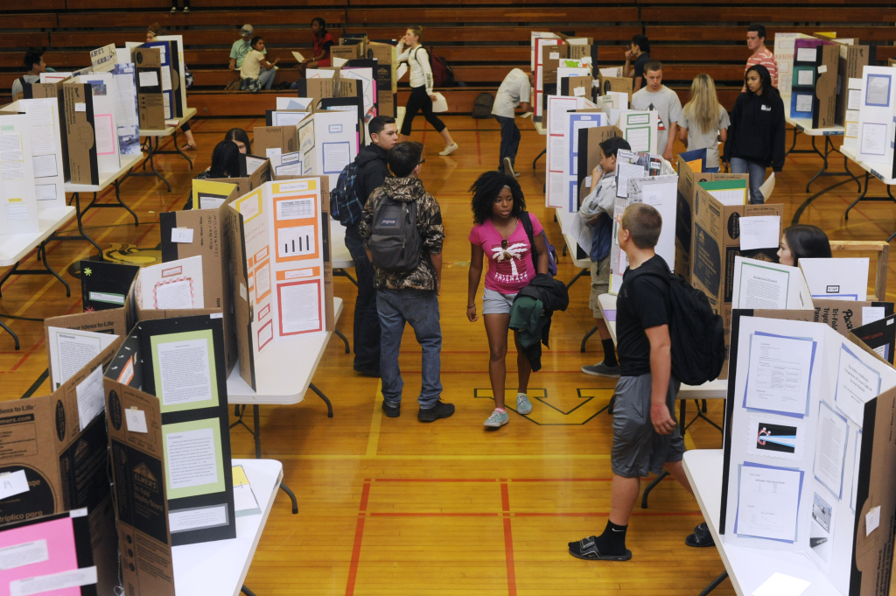
Parents and carers welcome
We will be having a proper FAIR where all of the projects will be displayed in the Main HALL (year 9) and The SPACE (year 8)
Wednesday July 6th
From 11:20am - 1:00pm

Slide 20
RECAP
All year 8 and all year 9 students are expected to participate (independently , pairs or team )
Time in advisory will be set aside to help you come up with a testable scientific question and to assist with general planning.
You will be given a planning pack to help you organise and plan your experiment. To work through in Friday Skills Builder time in advisory
However, much of this project must be completed at home
This may require you to meet out of school time with your team to carry out your experiment and make your model/presentation board
You will be observed by your advisors and be given recognition for the skills that you are able to demonstrate FOR SKILLSBUILDER (planning and final projects)
You are competing for medals, badges and a trophy and for your House
REMEMBER: This is an opportunity for you to show how your science skills and knowledge have improved over the course of the year and will contribute to your application process for student leaders and House badge nominations in the future

Slide 21
LOOKING FORWARD TO SEEING SOME REALLY GREAT PROJECTS!!!
Any Questions?

Slide 22
https://www.youtube.com/watch?v=97XQMq41K94
https://www.youtube.com/watch?v=Pbt7VaBTnJM

